Slide 1

SIWES PRESENTATION REPORT
Done at the Nigerian TeleVision authority
By Onigbode Nathan oluwasegun
With Matriculation number BHU/21/04/05/0027
Supervised by Mrs. Oluwatoyin adeyemo

Slide 2
Scope of presentation
Brief History Of SIWES
About Nigerian Television Authority
Organizational Chart
Technical Experience Gained
Software development experiences gained
Pictorial representation of experiences gained
Recommendation
Conclusion

Slide 3
Brief History of SIWES
The Students Industrial Work Experience Scheme (SIWES) was established in Nigeria by the Nigerian Universities Commission (NUC) in 1973, mandated to bridge the gap between theoretical knowledge and practical application in tertiary education. It was introduced to address the disconnect between classroom learning and industry requirements, aiming to enhance students' employability and prepare them for professional roles in various sectors (Nigerian Universities Commission, 2020).

Slide 4
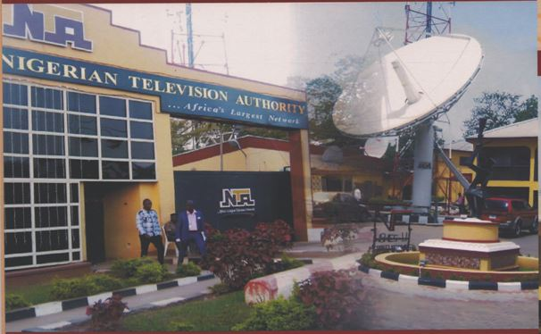
About the Nigerian television authority
The Nigerian Television Authority came into being in May 1977 through Decree 24 of 1977 which had retroactive effect from April, 1976. As at the last count, NTA has 101 Stations spread across Nigeria making it the largest Television Network in Africa. Currently, there are 10 operational network centers. These centers generate and uplink network programs for the network service. They are NTA Lagos, Ibadan, Kaduna, Enugu, Sokoto, Benin, Port Harcourt, Makurdi, Jos and Maiduguri. The core mandates of the NTA are News and Programs. These mandates are discharged by the operations of the Directorates of News, Programs and Engineering and the newly established Multi-channels.

Slide 5
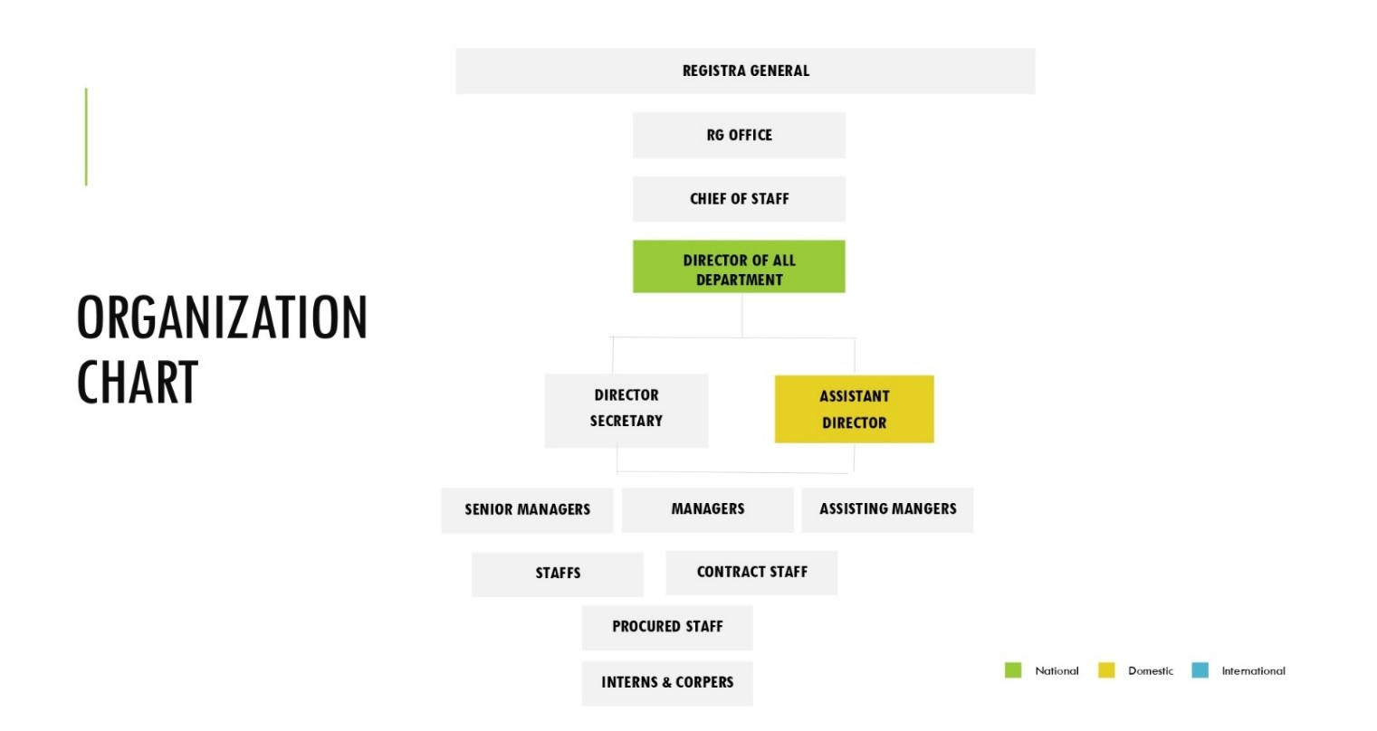
Organizational Chart

Slide 6
Technical Experience Gained
Technical Support: I was able to work with support officers and so learnt how to set up and configure new systems, troubleshoot hardware problems, network and internet issues, configure virtual private networks (OpenVPN) and provide support during training sessions.
Video editing: I was taught how to use the adobe premiere software for video editing and was also given the opportunity to experiment with its features which include color formatting, image clipping, text animations, video effects, and transitioning to deliver good contents for the commission.

Slide 7
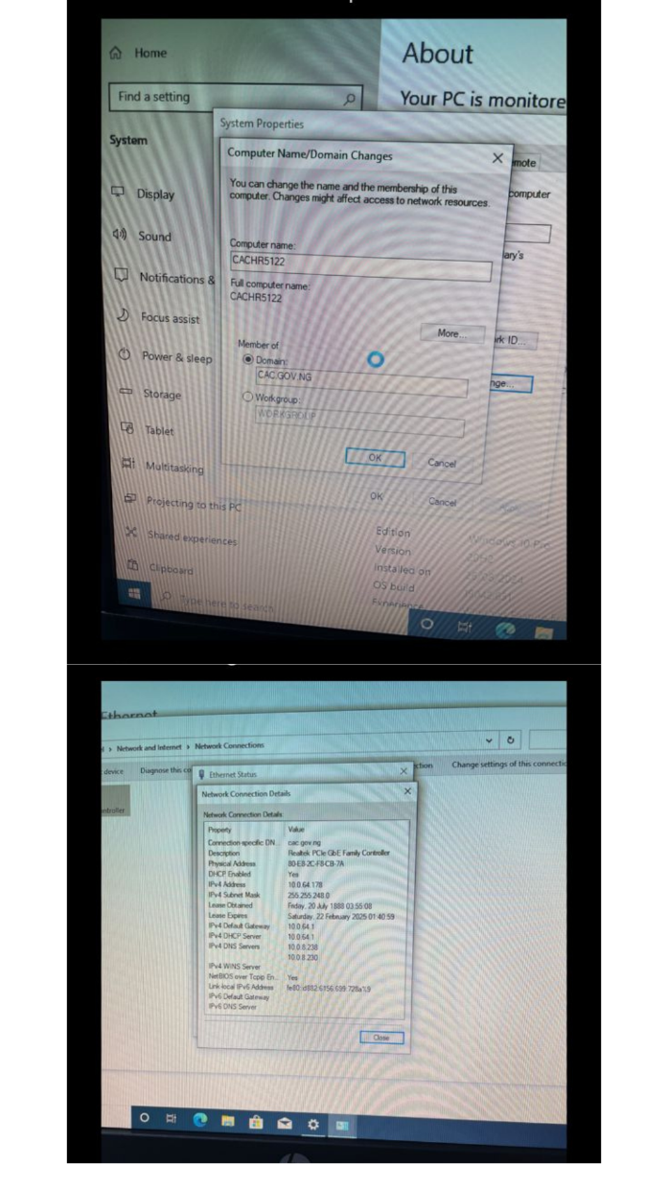
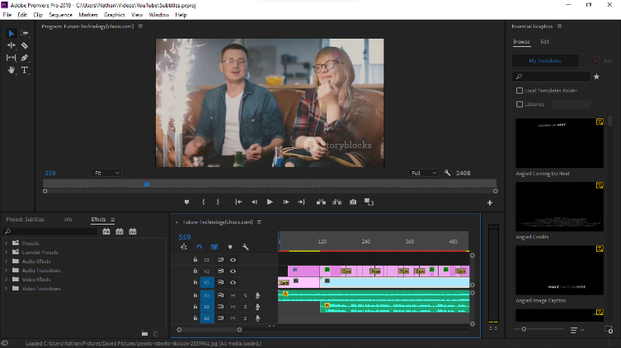
Pictorial Representation of my Technical Experiences gained
Edit view of the Adobe Premier Pro
Configuration of the network settings of a new computer system

Slide 8
Software development experiences gained
Data Analytics: I gained experience in data analytics using MySQL, power bi, and python for data collection, cleaning, visualization, and analyses to generate insights. I was able to analyze and visualize some financial data for the department which enabled me to work with more confidential data in the commission.
Machine Learning: I learnt core machine learning concepts, including natural language processing, artificial neural networks, confusion matrix. classification, clustering, and using data for model training and testing. My experience included building, training, scaling and evaluating models for various machine learning applications.

Slide 9
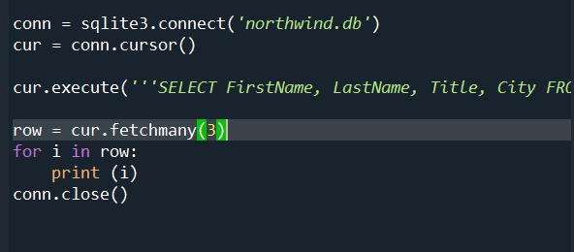
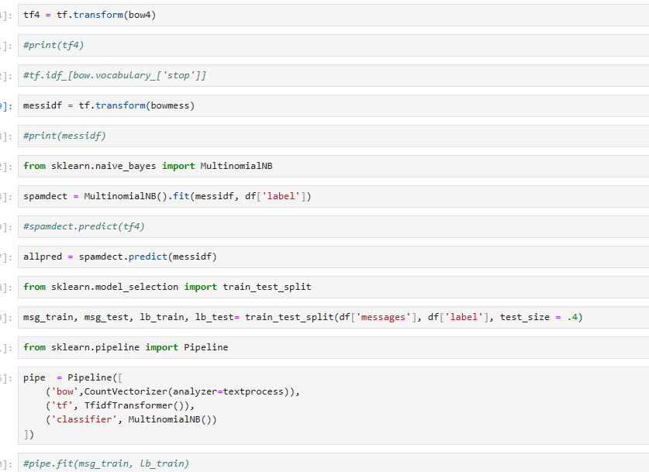
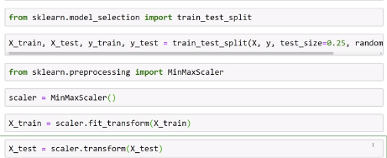
Pictorial Representation of my software Experiences gained
Fetching and printing the first 3 rows in a database using python
Transforming a data set to a model and training it.
Code block for training and fitting a model

Slide 10
RECOMMENDATION
Based on my SIWES experience, I recommend that future practitioners of Computer Science in the SIWES programs focus on acquiring practical skills in quality control, network debugging, and all round technological know-how. Active engagement in industrial settings enhances professional development and prepares students to meet industry standards and challenges effectively. The internship provided practical insights into realistic applications of computer science, technical support, and software development, equipping me with skills vital for the digital industry.

Slide 11
Conclusion
The experiences gained in the ICT department at Nigerian Television Authority were very enlightening and helpful to increasing my understanding of the real world. By actively participating in technical support, I acquired essential skills in analytical computing, computer operations, and technical management. These competencies are critical for ensuring computer ethics, meeting regulatory requirements, and supporting sustainable computer management practices in organizations especially those planning towards digitalization. The practical experiences gained from these six months serving in Nigerian Television Authority are directly applicable to real-world scenarios, significantly more in computer science and technical analysis.

